Slide 1
Euclid algorithm
Prof. Dr. Shailendra Bandewar

Slide 2
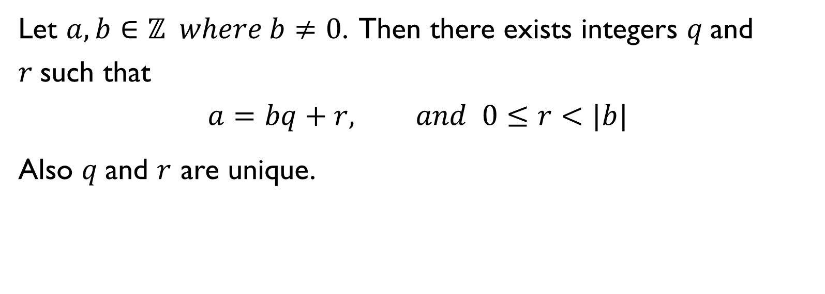
Division algorithm
Let $a, b∈ℤ where b≠0$. Then there exists integers $q$and $r$such that
$$a=bq+r, and 0≤r<|b|$$
Also $q$and $r$ are unique.

Slide 3

Example
Find $q and r such that a=bq+r$
$a=4461 and b=16$.
$a=−262 and b=3$.
$$∴$$

Slide 4
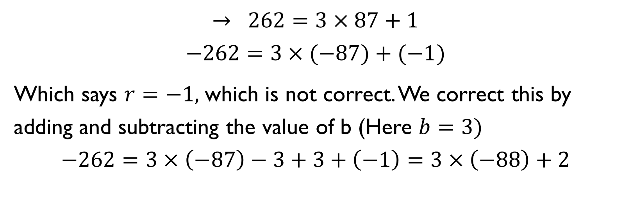
$$→ 262=3×87+1$$
$$−262=3×(−87)+(−1)$$
Which says $r=−1,$which is not correct. We correct this by adding and subtracting the value of b (Here $b=3)$
$$−262=3×\left(−87\right)−3+3+\left(−1\right)=3×\left(−88\right)+2$$

Slide 5
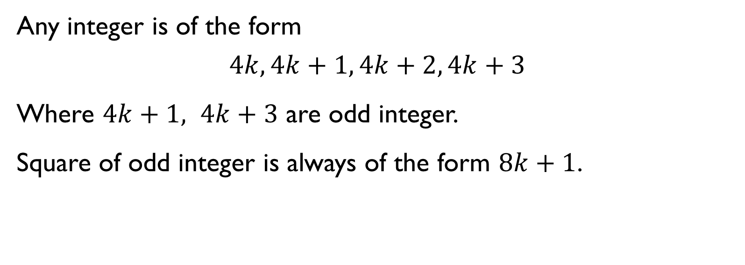
Important property of an integer
Any integer is of the form
$$4k, 4k+1, 4k+2, 4k+3$$
Where $4k+1, 4k+3$ are odd integer.
Square of odd integer is always of the form $8k+1$.

Slide 6

divisibility
a divides b written as $a|b$ means there exists some integer $k$ such that
$$b=ak$$

Slide 7
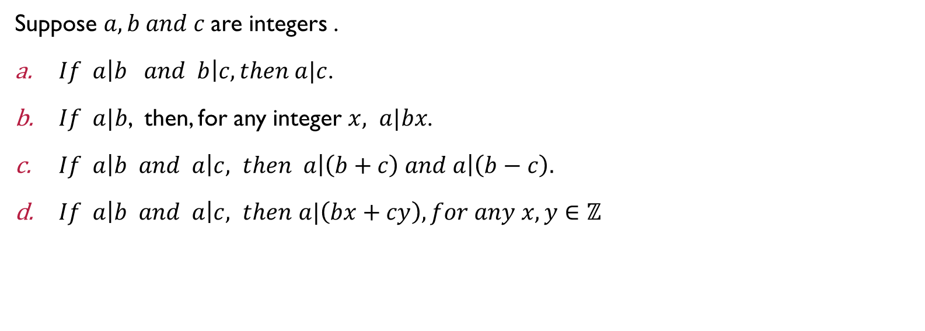
Theorem
Suppose $a,b and c$are integers .
$If a\left|b and b\right|c, then a|c$.
$If a|b$, then, for any integer $x, a|bx$.
$If a\left|b and a\right|c, then a\left|\left(b+c\right) and a\right|\left(b−c\right).$
$If a\left|b and a\right|c, then$ $a|\left(bx+cy\right), for any x, y∈ℤ$

Slide 8
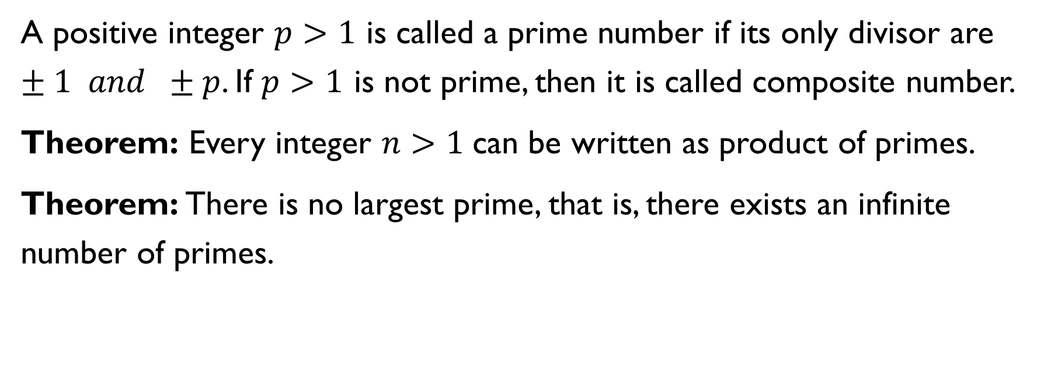
primes
A positive integer $p>1$ is called a prime number if its only divisor are $±1 and ±p$. If $p>1$ is not prime, then it is called composite number.
Theorem: Every integer $n>1$can be written as product of primes.
Theorem: There is no largest prime, that is, there exists an infinite number of primes.

Slide 9
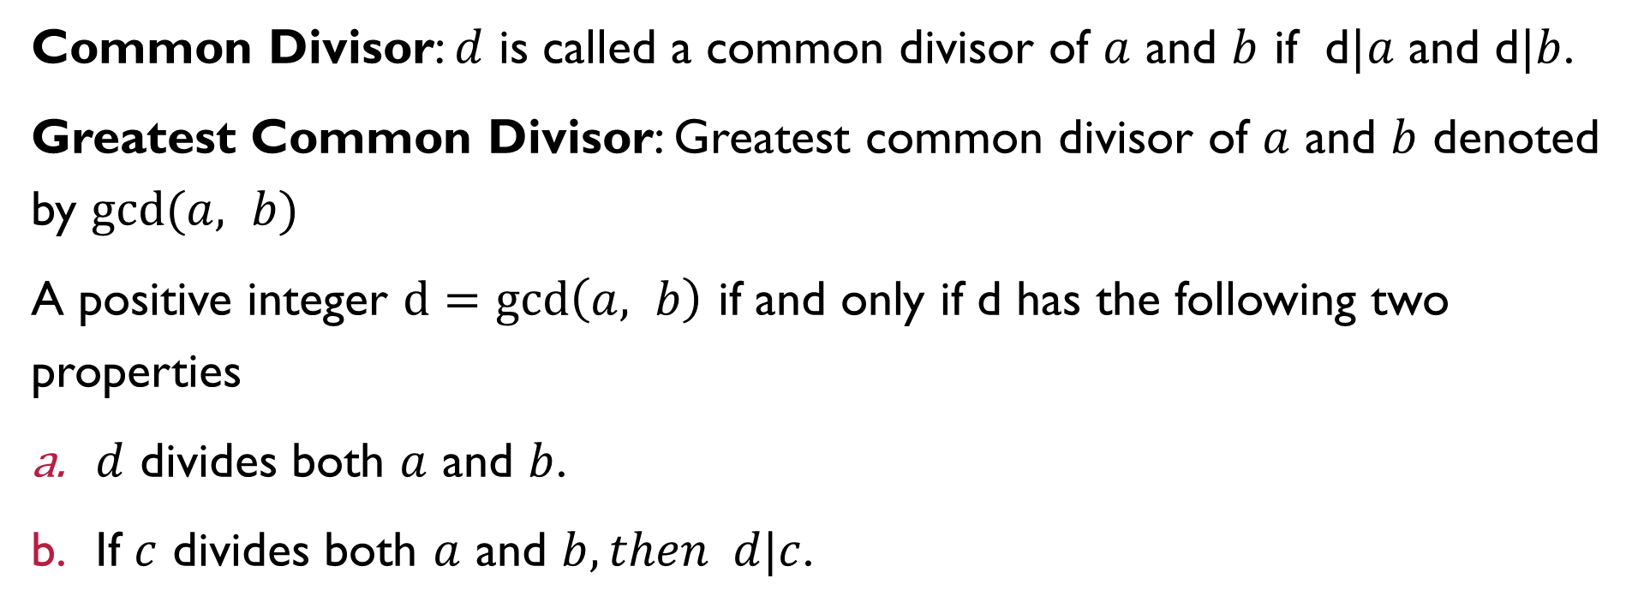
Greatest common divisor
Common Divisor: $d$ is called a common divisor of $a$ and $b$ if d$|a$ and d$|b$.
Greatest Common Divisor: Greatest common divisor of $a$ and $b$ denoted by $gcd⁡(a, b)$
A positive integer $d=\gcd\left(a, b\right)$ if and only if d has the following two properties
$d$ divides both $a$ and $b$.
If $c$ divides both $a$ and $b, then d|c$.

Slide 10
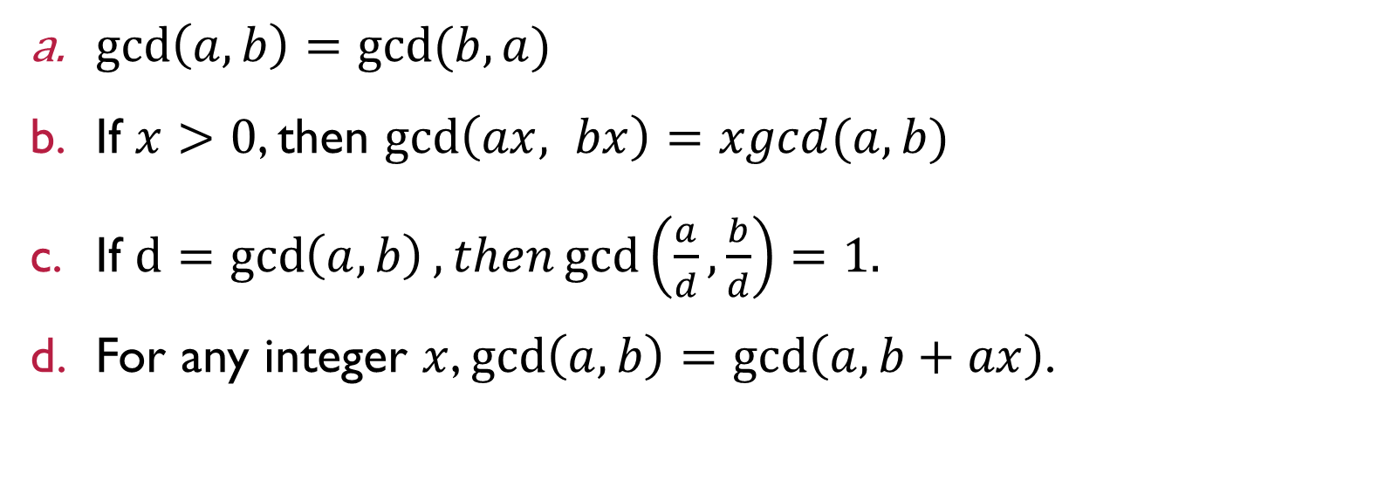
Properties of greatest common divisor
$\gcd\left(a, b\right)=gcd⁡(b,a)$
If $x>0$, then $\gcd\left(ax, bx\right)=xgcd(a,b)$
If $d=gcd\left(a, b\right), then\gcd\left(\frac{a}{d},\frac{b}{d}\right)=1.$
For any integer $x$, $\gcd\left(a, b\right)=\gcd\left(a, b+ax\right)$.

Slide 11

Theorem
If $a=bq+r$, then $\gcd\left(a, b\right)=\gcd\left(b,r\right).$
$d=gcd\left(a, b\right), then d=ax+by for some x, y∈ℤ$

Slide 12
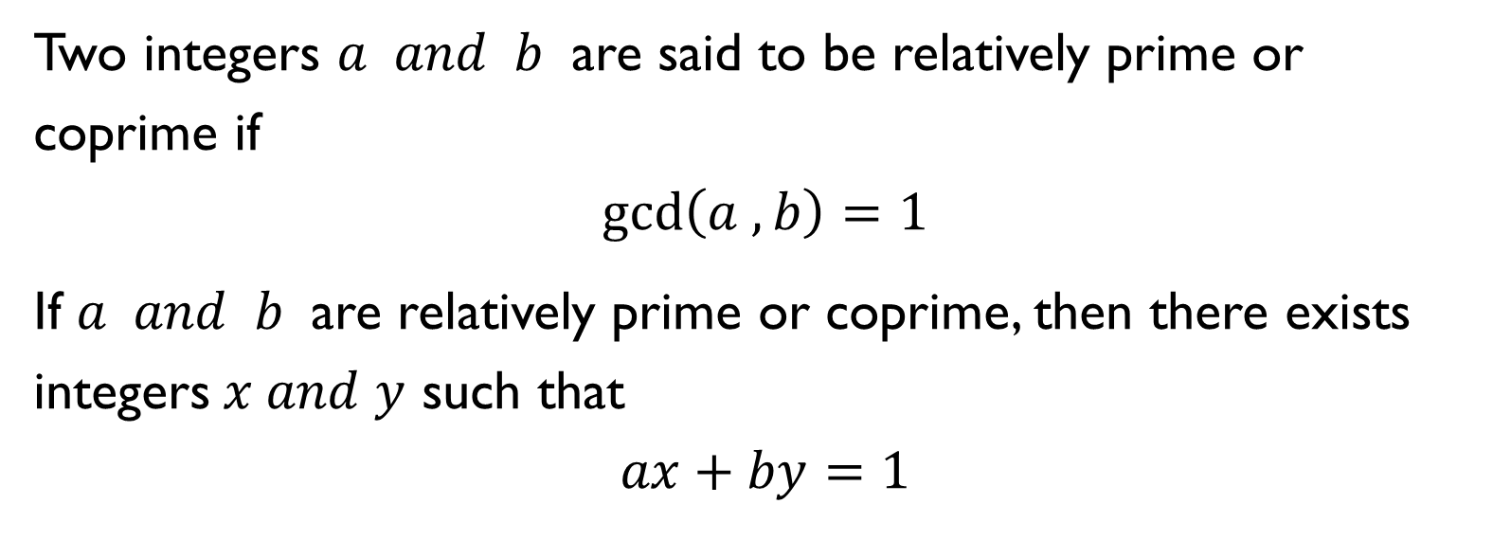
Relatively prime integers
Two integers $a and b$ are said to be relatively prime or coprime if
$$\gcd\left(a , b\right)=1$$
If $a and b$ are relatively prime or coprime, then there exists integers$x and y$ such that
$$ax+by=1$$

Slide 13
Theorem
If $a=bq+r$, then $\gcd\left(a, b\right)=\gcd\left(b,r\right).$
$d=gcd\left(a, b\right), then d=ax+by for some x, y∈ℤ$

Slide 14
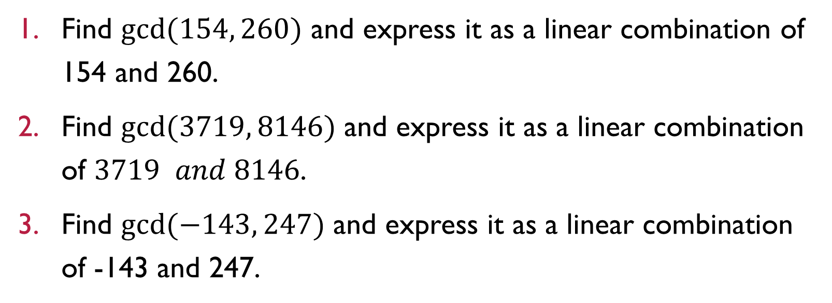
Euclidean algorithm
Find $gcd⁡(154, 260)$ and express it as a linear combination of 154 and 260.
Find $gcd⁡(3719, 8146)$ and express it as a linear combination of $3719 and 8146$.
Find $gcd⁡(−143, 247)$ and express it as a linear combination of -143 and 247.

Slide 15

Example
1. Find an integer m and n such that $9m+11n=4$.

